Slide 1
“SMART INDIA HACKATHON 2024”
PROBLEM STATEMENT ID- SIH1648
PROBLEM STATEMENT TITLE- “ONLINE CHATBOT BASED TICKETING SYSTEM”
THEME- “TRAVEL&TOURISM”
PS CATEGORY- “SOFTWARE”
TEAM NAME-”TEAM CODE CREW”

Slide 2

“INTRODUCTION”
Introducing our online” chat bot ticketing system from our team
“THE CODE CREW”
An advanced platform designed to automate and streamline the ticketing process.
With 24/7 support it, efficiently handles ticket creation ,tracking,and resolution ,ensuring
Timely assistance and enhanced user satisfaction.
GOAL:Improve efficiency,reduce response time ,and provide a seamless user experience

Slide 3
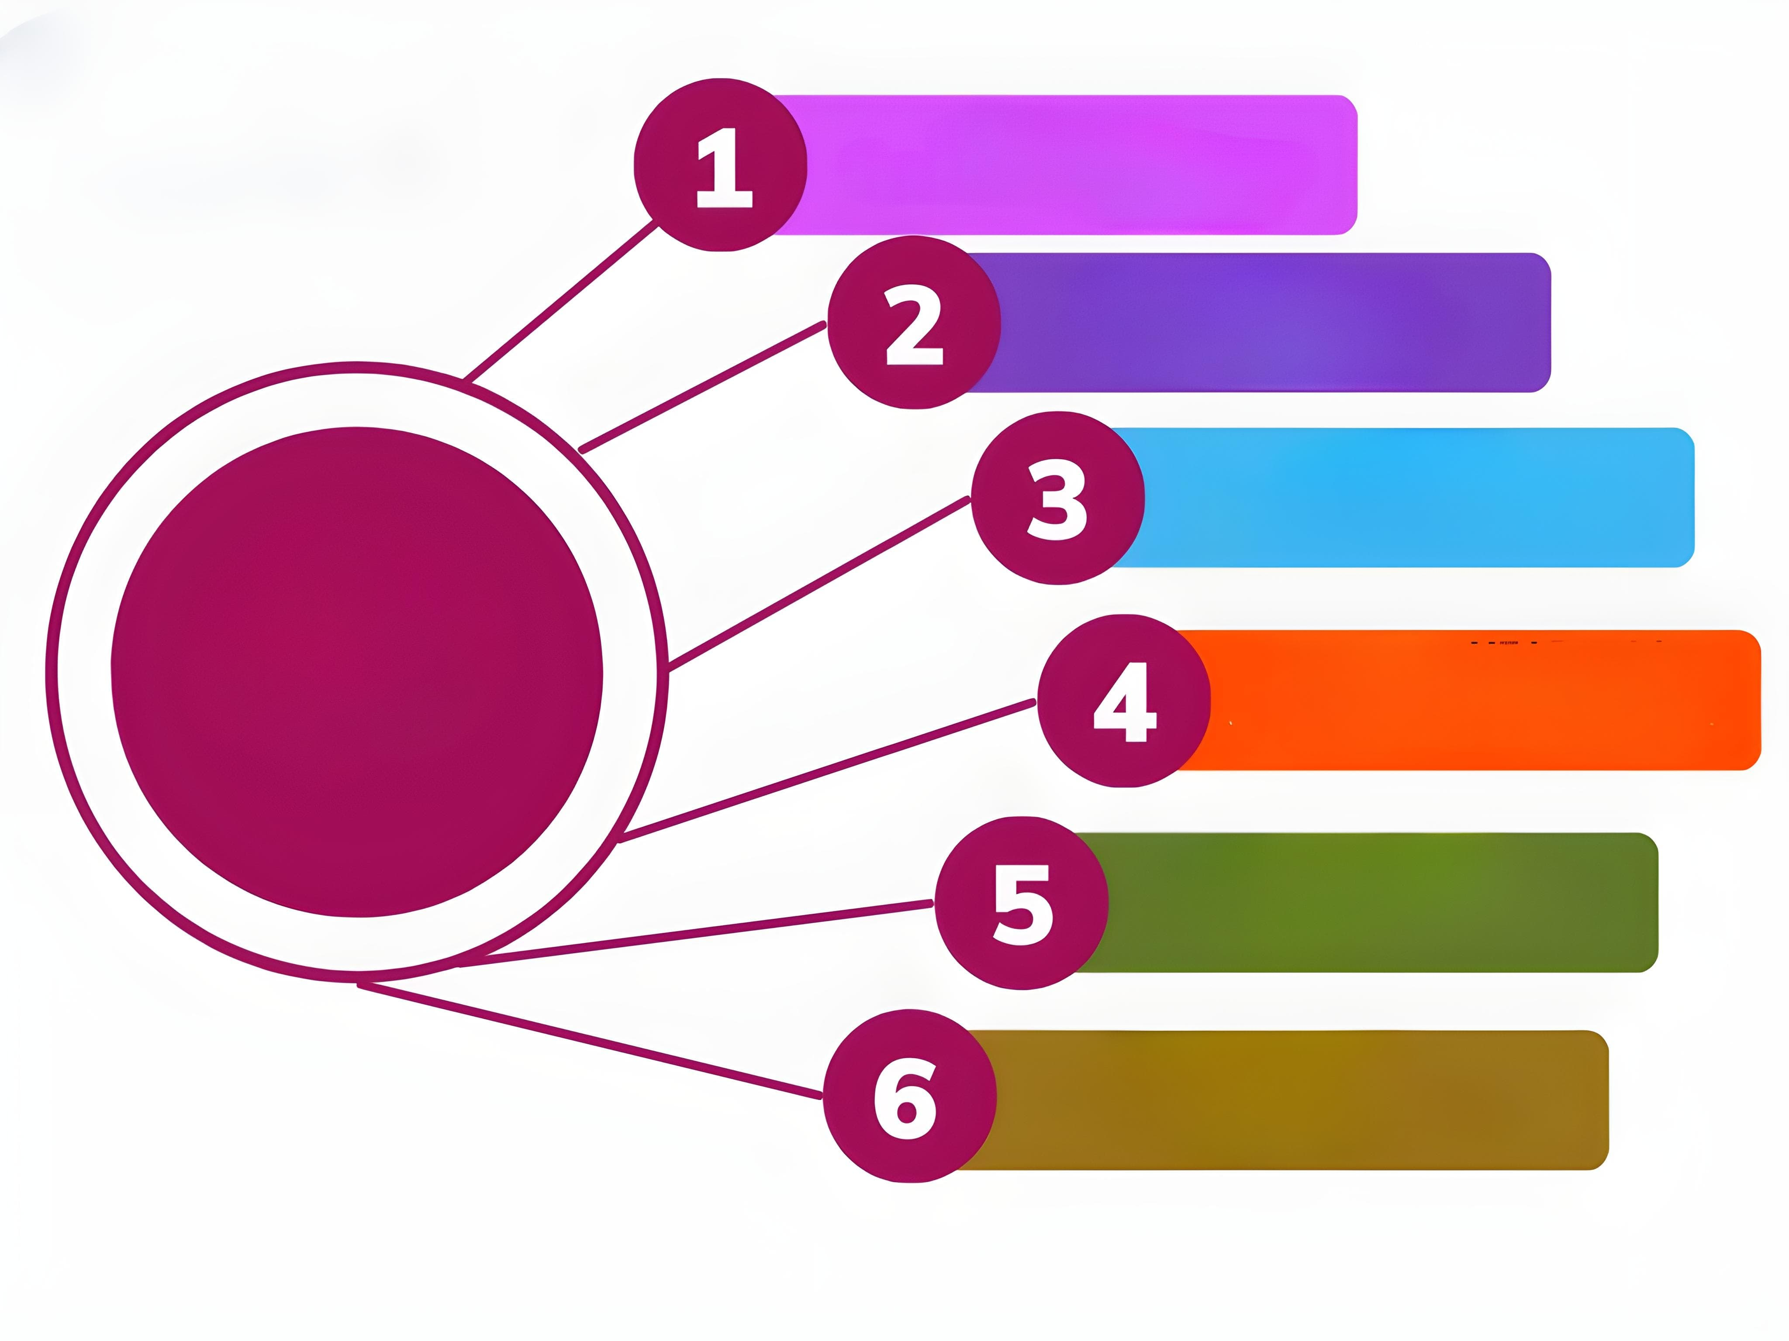
Providing best ideas
to visit places
Finding shortest route
To minimize fare
To
Enhance
Services
Availing guide to the
tourists
Checking vacancy for
The taxi’s
Giving best lodges
Local/Starred
Less errors of information

Slide 4
PROBLEM STATEMENTS”
“CURRENT ISSUES”
Delayed ticket resolution
High workload on support staff.
Inconsitent response quality.
Limited support availibity.
.

Slide 5
“SOLUTION OVERVIEW”
CHATBOT - BASED TICKETING SYSTEM:
Automated ticket creation and management.
24/7 support with instant responses.
Intelligent routing and prioritization.
User-friendly interface for both customers and support staff.

Slide 6


“KEY FEATURES”
AUTOMATED TICKET CREATIONS
User initiates a chat; the bot gathers the details and creates the ticket.
INTELLIGENT ROUTING
Routes ticket to appropriate department
PRIORITIZATION
Automatically prioritizes ticket based on urgency and keywords
REAL TIME UPDATES
Provide real time updates and resolution times

Slide 7
“PROBLEM SOLVING APPROCHES”
REDUCE RESPONSE TIME
Use predefined templates and AI generate instant responses.
ENHANCE ACCURACY:
Train the chatbot with machine learning models to improve understanding and responses.
USER EXPERIENCE:
Design an intuitive interface with easy navigation and clear instructions.

Slide 8
“IMPLEMENTATION STRATEGY”
PHASE 1:DESIGN &DEPLOYMENT:
Define requirements , create chatbots workflows , and develop core features.
PHASE 2: INTEGRATION&TESTING:
INTEGRATE WITH EXISTING SYSTEMS AND TRAIN CHATBOT WITH CUSTOMERS FEEDBACK.
PHASE 3: DEPLOYMENT&MONITORING:
Launch the system, monitor performance , and make iterative improvments.

Slide 9
“BENEFITS”
EFFICIENCY:
Automate routine tasks and reduces manual effort.
AVAILIBILTY:
Provides 24/7 support , ensuring help is always available.
Scalibity:
Easily handles a large volume of tickets without additional resources

Slide 10
“FUTURE ENHANCEMENTS”
ADVANCED ANALYSIS:
Use data analytics to gain insights into ticket trends and user needs.
MULTILINGUAL SUPPORT:
Extend chatbot capabilities to handle multiple languages.
Voice Integration:
Incorporate voice recognition for hands free ticketing.

Slide 11
“CONCLUSION”
SUMMARY:
The Chatbot – based ticketing system offers a modern solution to enhance support efficiency and user satisfaction.
CALL TO ACTION:
Encourage feedback, collaboration and further development to refine and expand the system.

Slide 12
THANK YOU
WORK BY : CODE CREW
SUJAL PRASAD
PRAVESH SHARMA
ATUL GAUTAM
YASHIKA GAUTAM
ARYAN GUPTA
AASHISH KR PRASAD

